Slide 1

The Globetrotters
Progress: Trotter the Interactive Levitating Globe
Week in Review: ___________________________________

Slide 2
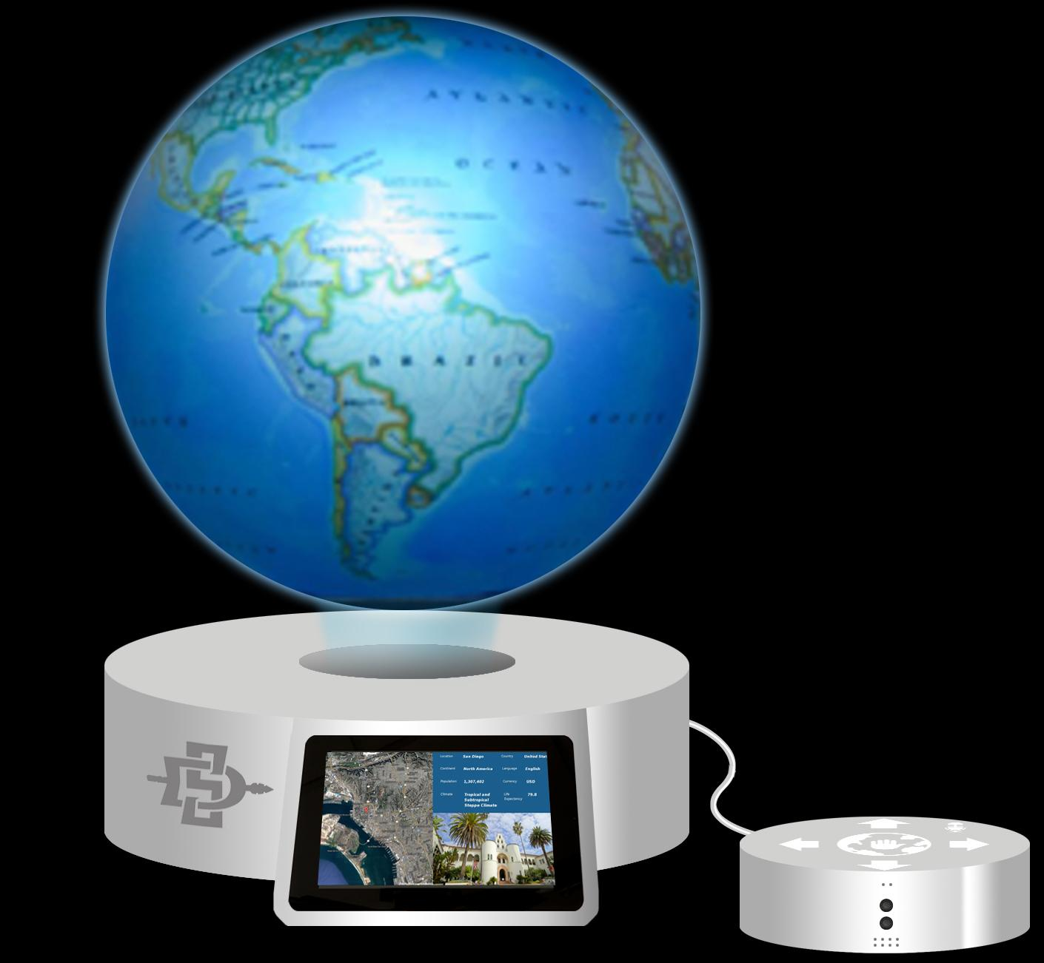


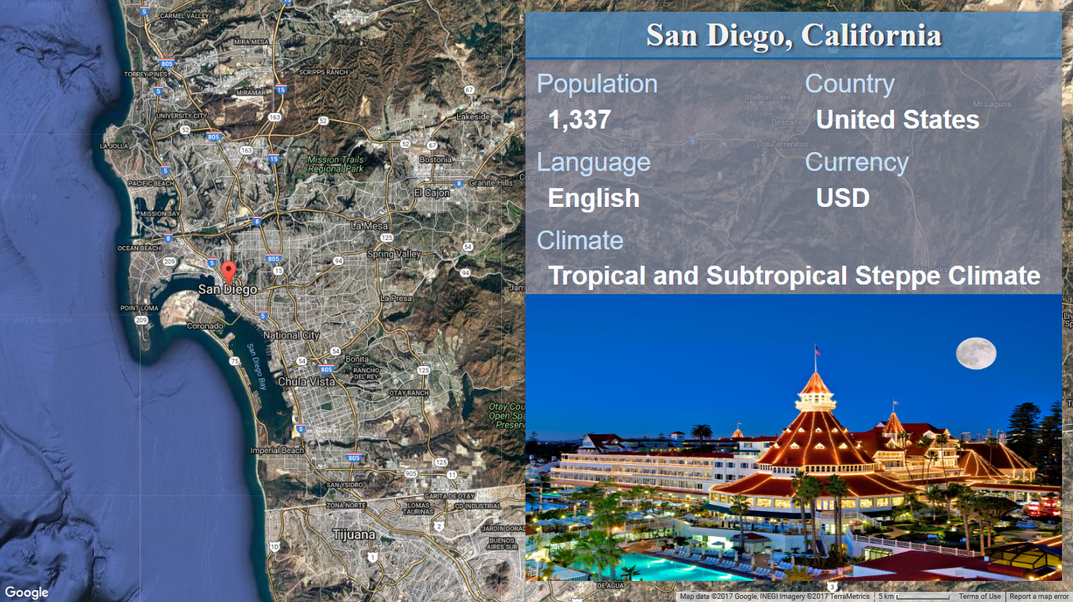
Sponsors

Slide 3
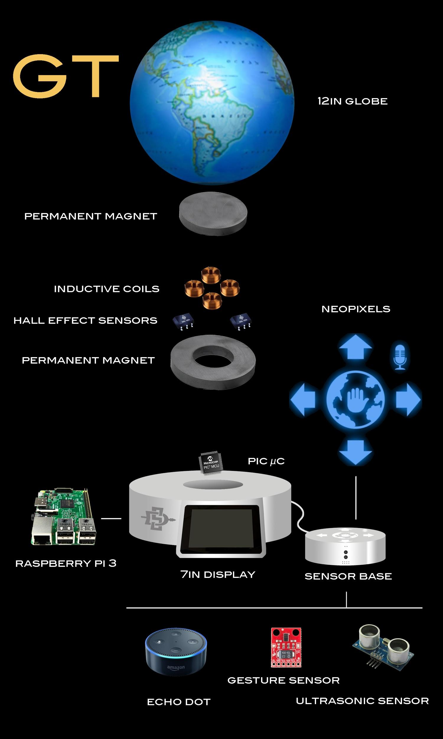
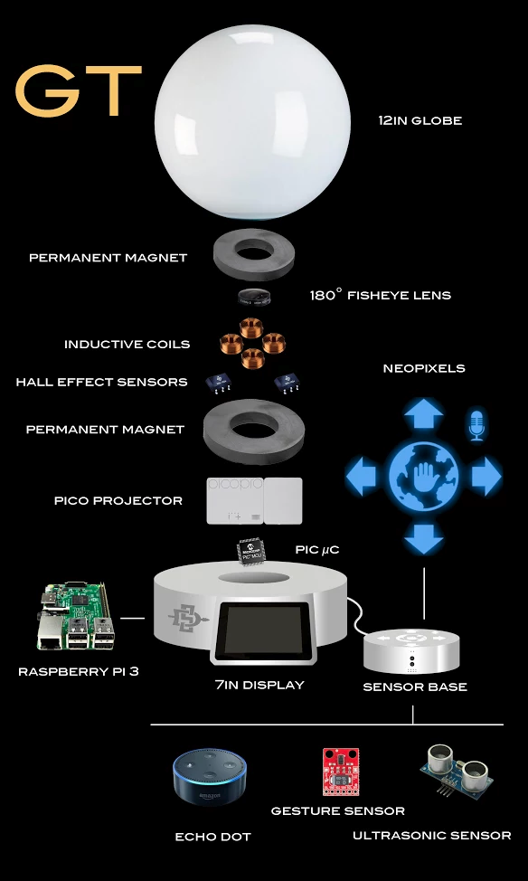
Physical
Projection
&

Slide 4
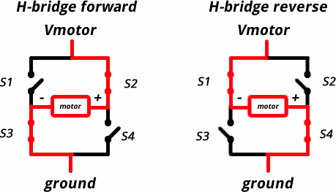
Focusing on the Base of the System
(Base ring magnet $18.00)
7” OD, 3.75” ID, by 0.8” Thick
-Electromagnetic circuitry (H-Bridge)
Reminder
Notes:
Modify Image to reflect Physical Rotation

Slide 5
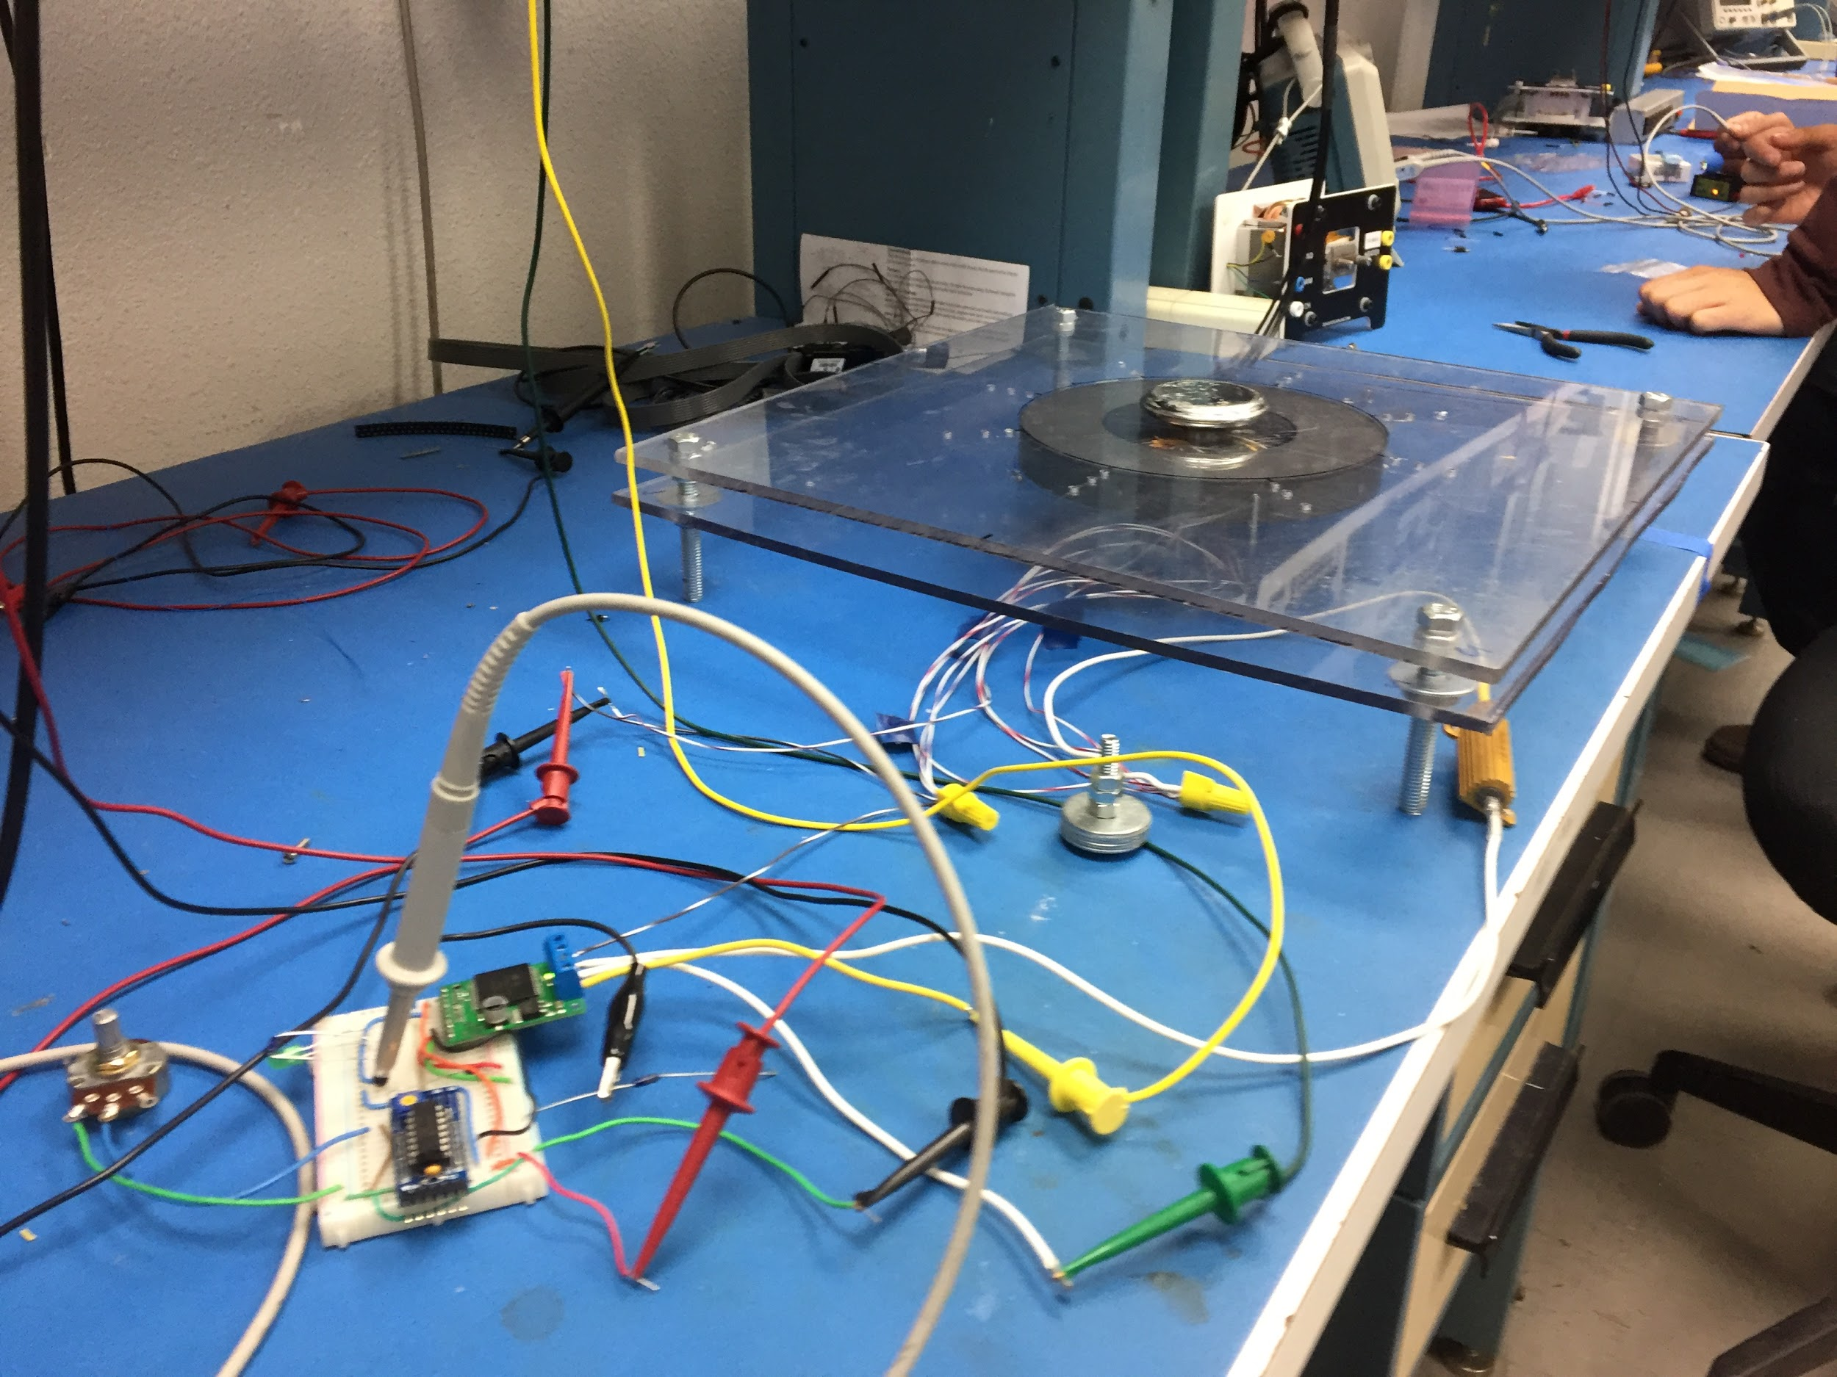
Constructing a Testing base
-Adjustable base for changing out magnets, plexiglass to see internal connections
-provides protection and insulation from Hot wires

Slide 7
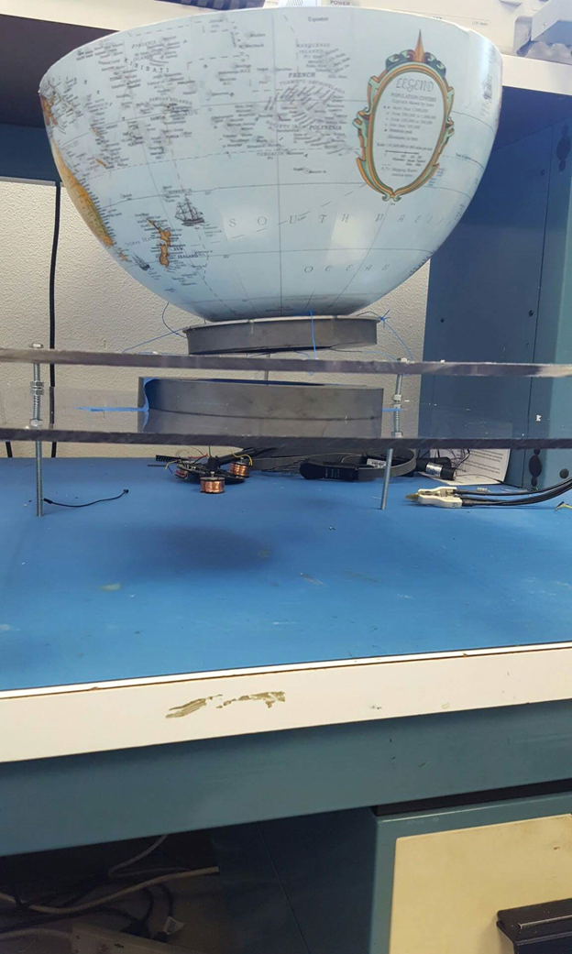
Electromagnetic Levitation
Two permanent magnets
Base - 7in
Globe base - 5.5in
Rig capable of holding 3+ pounds
Earnshaw’s Theorem
Theoretically impossible
Must achieve stability with additional means
Notes:
A theorem attributed to Ernshaw proves it impossible to obtain a static levitation by using a combination of fixed magnets. The static levitation implies a stable suspension of one item against gravity.

Slide 9
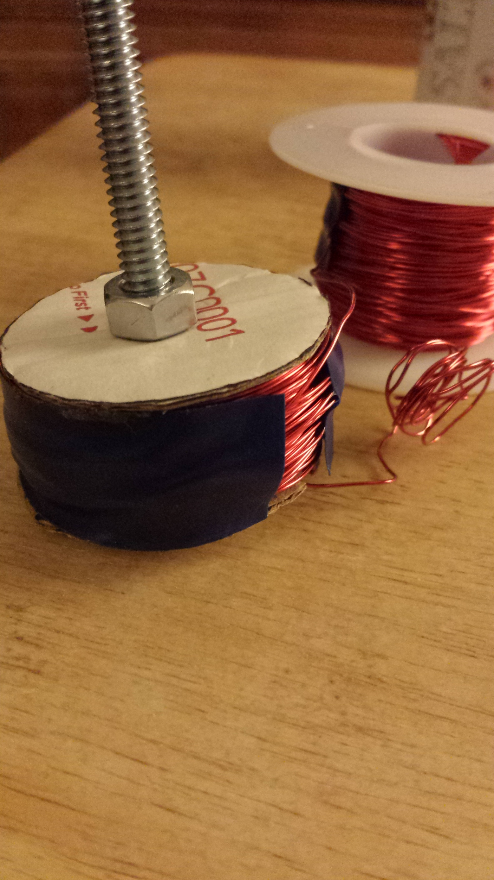
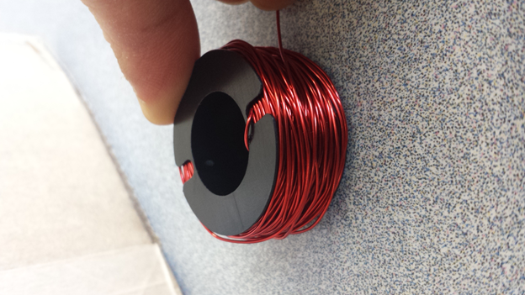
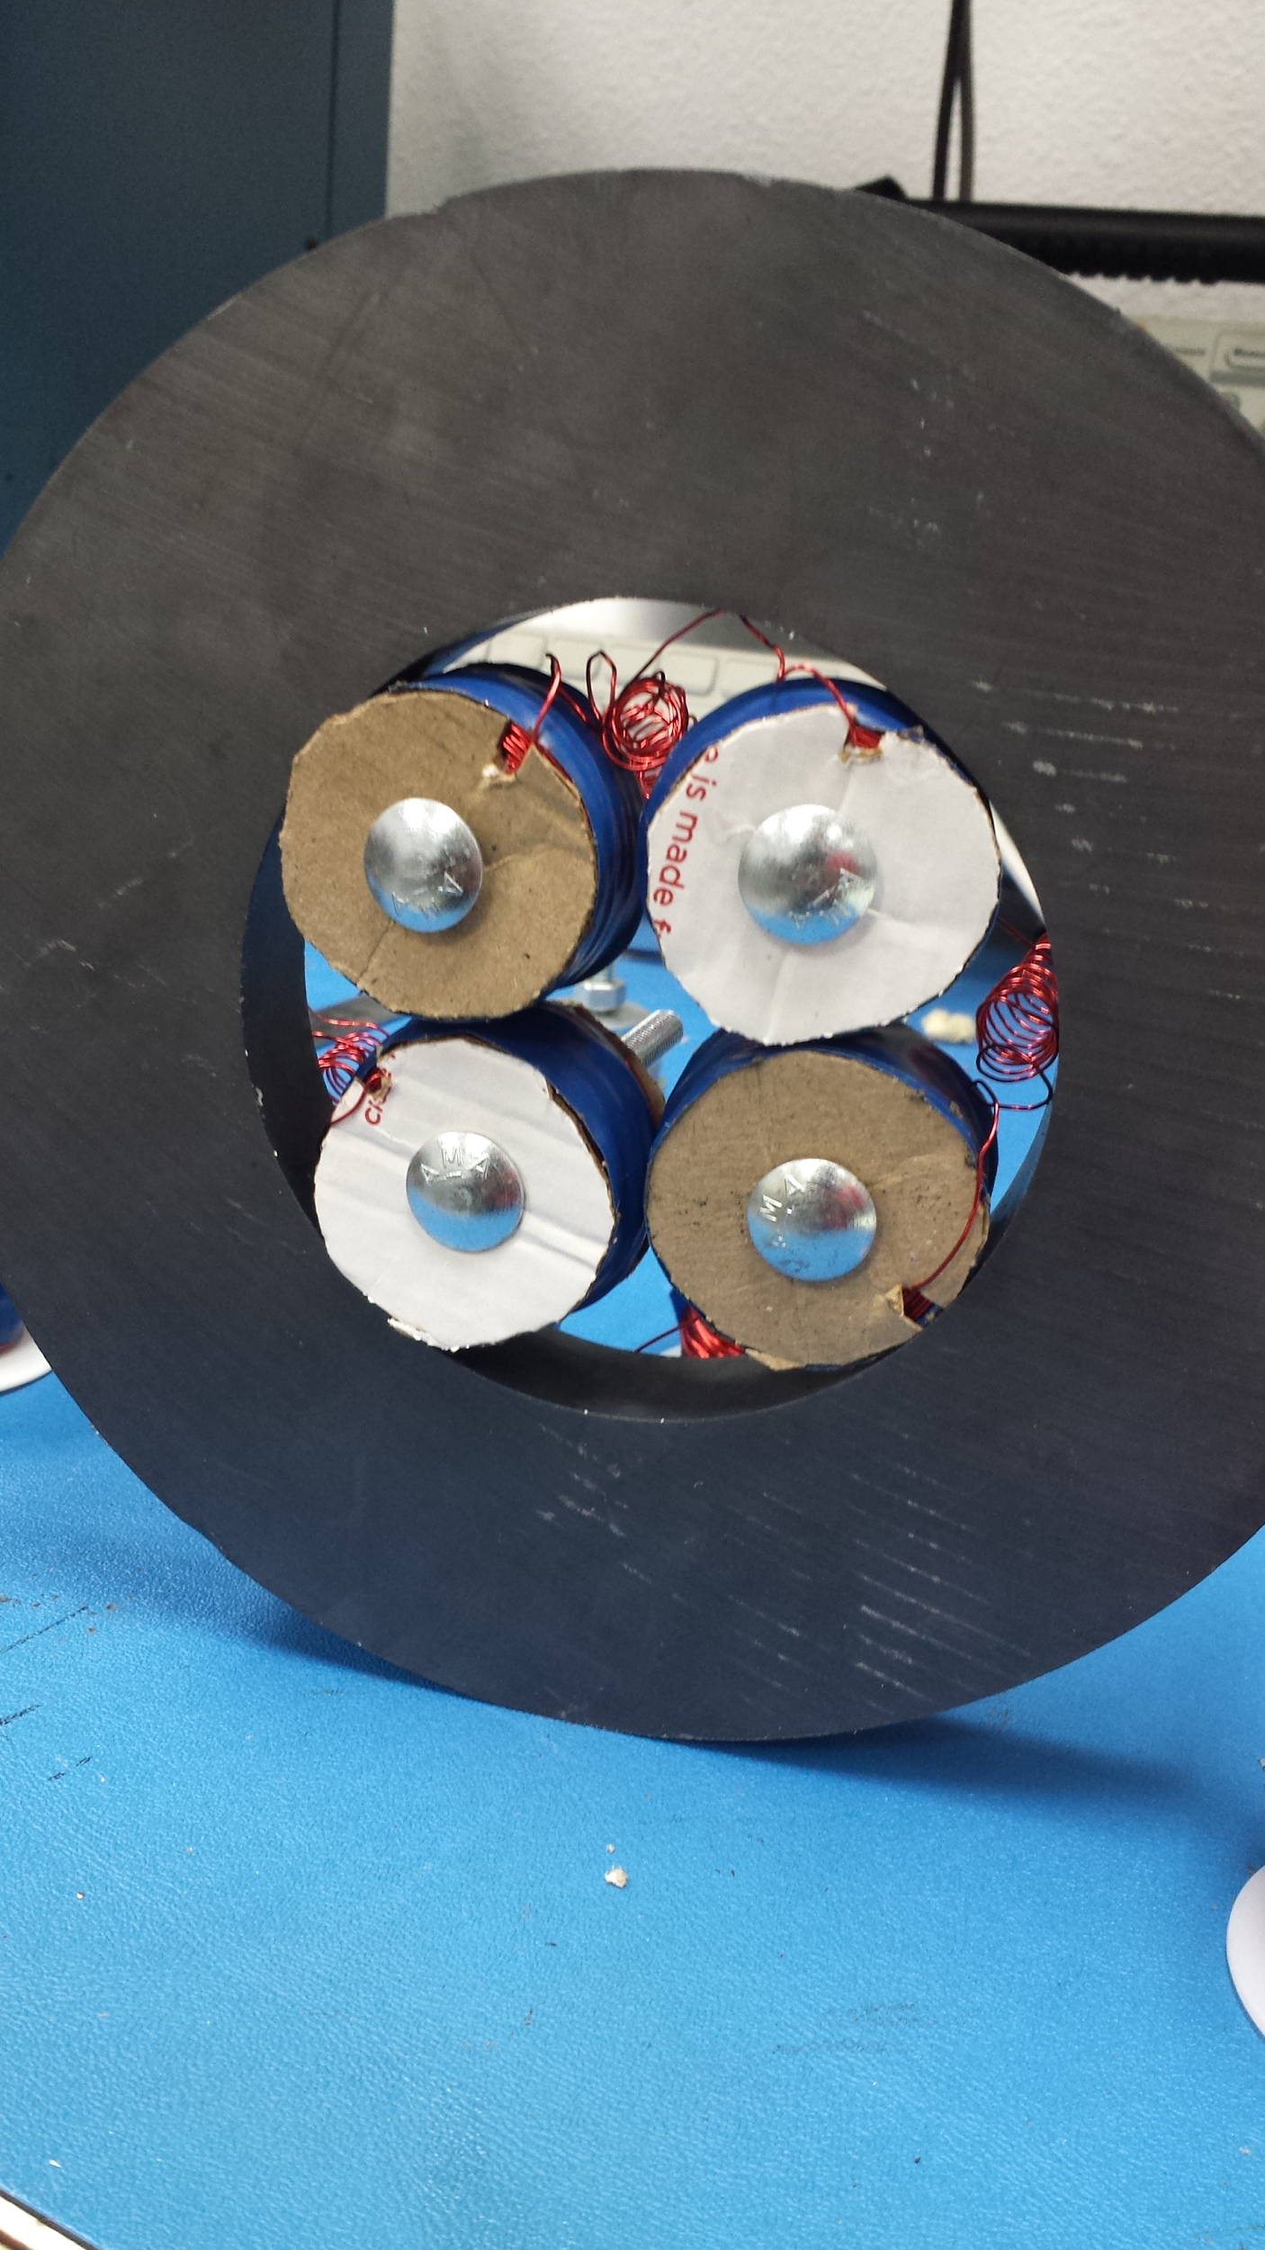
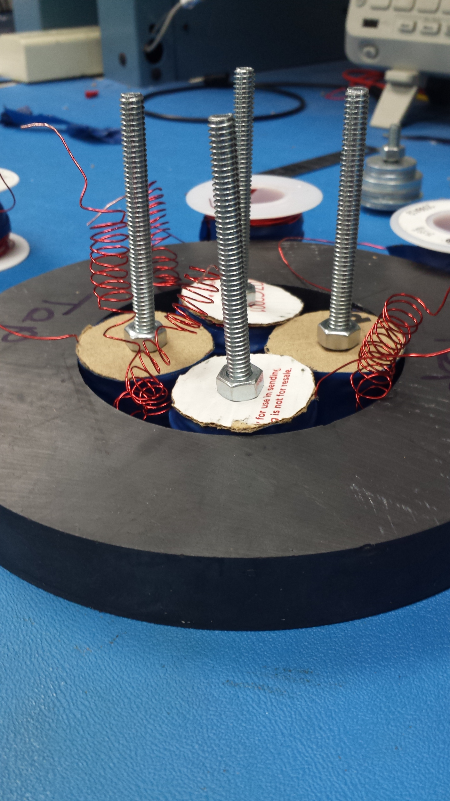
Coils - Maintaining Stability
Bobbins
20cm x 30cm
Extended using cardboard
Coil parameters (Roughly 300 turns)
Inductance - 3.3µH
Resistance - 2.75𝛀
Connected in series - 5𝛀
One current going through the pair
@100% duty cycle - 24V, 5A
Controlled by Hall Effect sensors

Slide 10
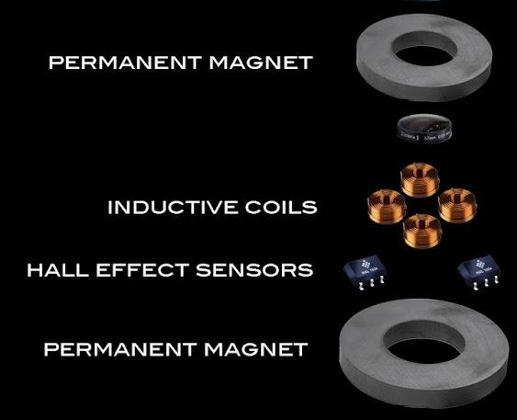
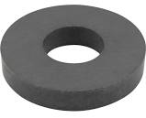
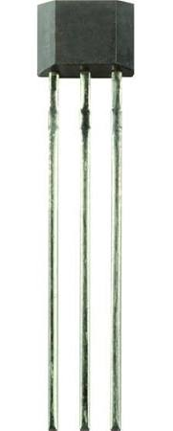
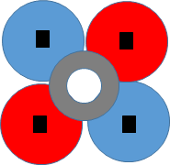
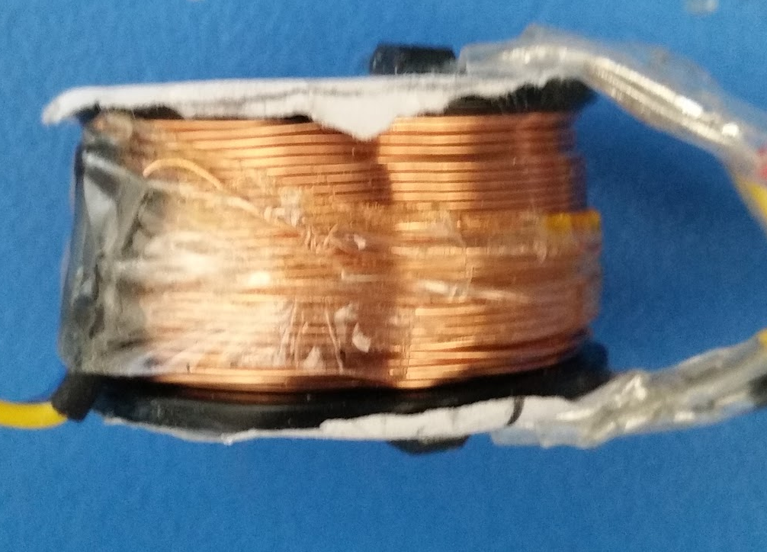
Magnetic Levitation - Control System
Large permanent magnet to produce all lifting force
4 electromagnetic inductors
8 Hall Effect Sensors
As the magnet moves towards 1, current flows into electromagnets 1 and 4 pushing back towards ZPP
Differential Amp to cancel EM
1
2
3
4

Slide 11
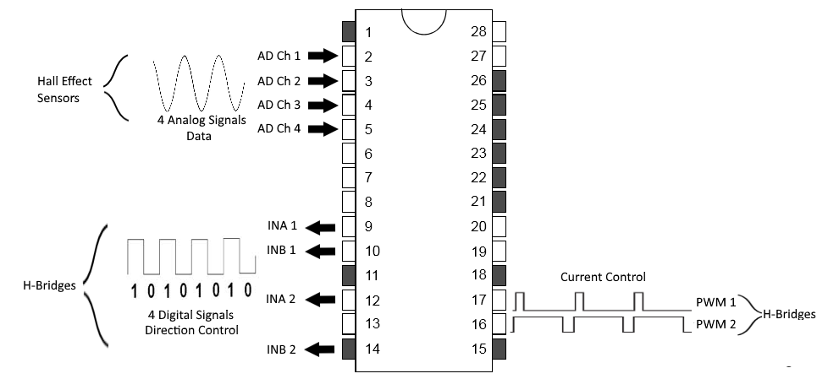
PIC24EP64GP202
Notes:
In our final design we’ll be using a PIC24 microcontroller for the levitation’s control system. We’ve configured it to use 4 analog input channels using one ADC which correspond to each one of the 4 pairs of hall effect sensors. Based on these values, we’re toggling 4 digital output pins to control the direction the two H-Bridges with the corresponding INA and INB pins and we’ll have two PWM signals that will control the current through each pair of coils, where low duty cycle is less force and high duty cycle is more force.

Slide 12
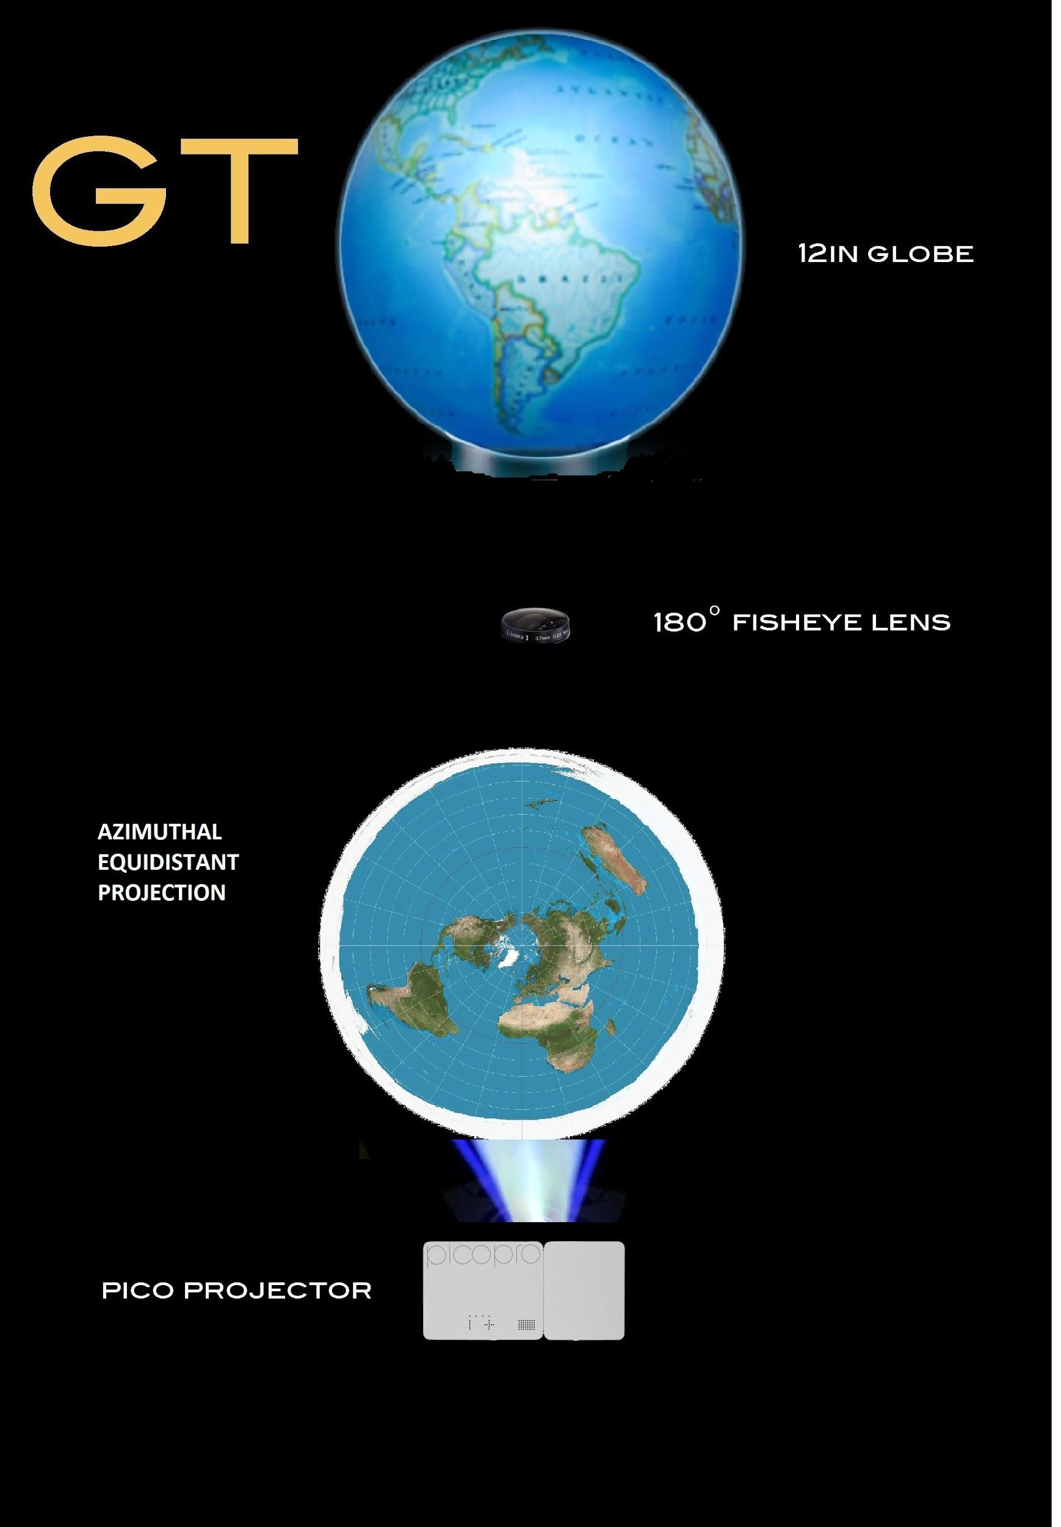
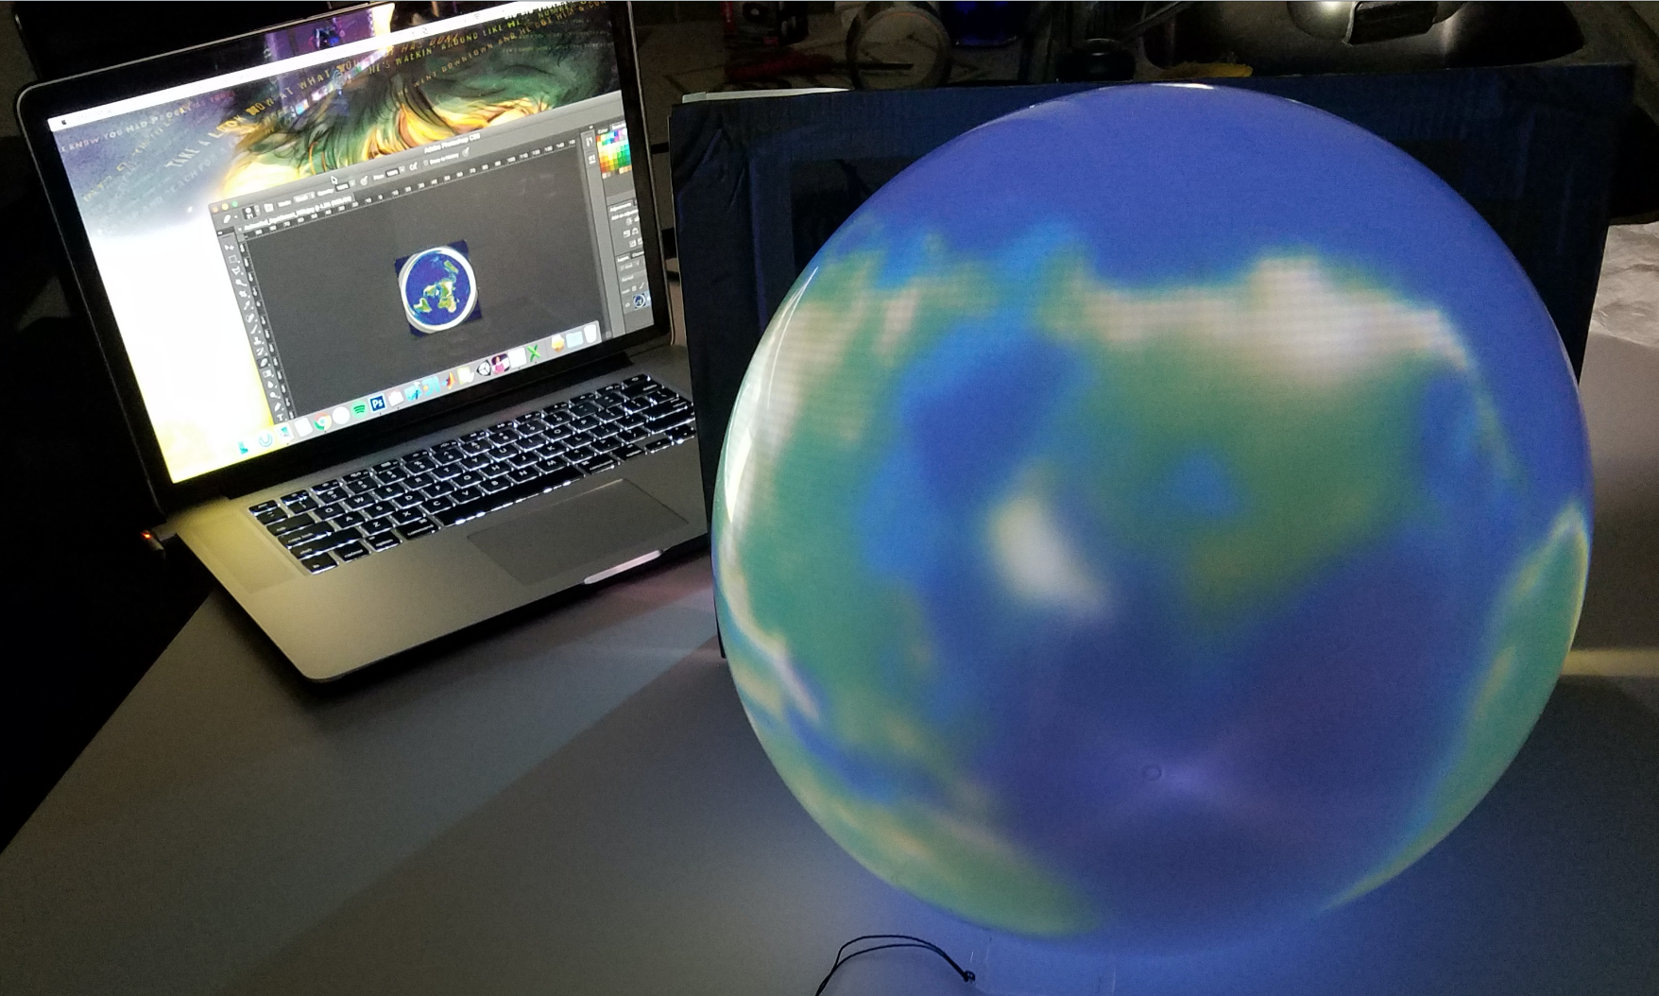
Projection & Rotation

Slide 13
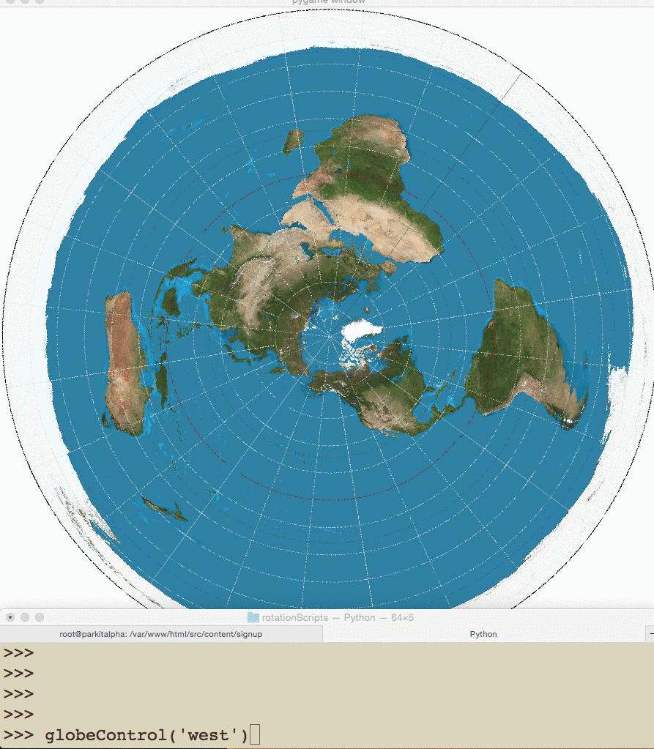
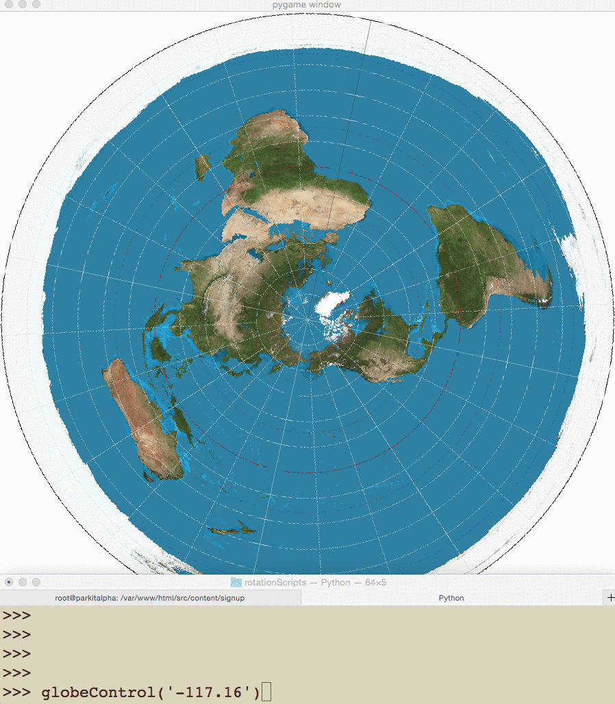
Rotation Script Interaction

Slide 14
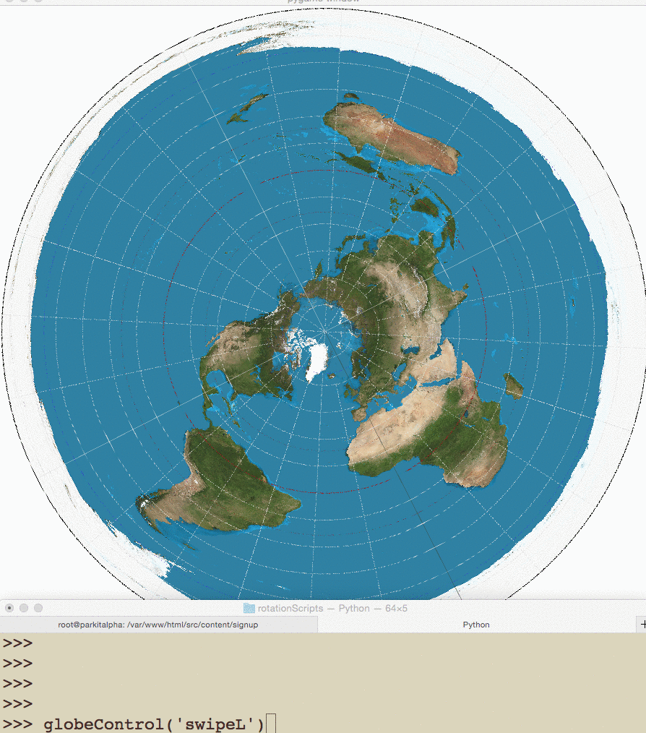
Rotation Script Interaction

Slide 15
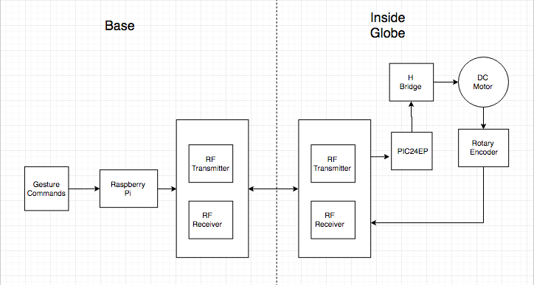
Physical Globe Rotation

Slide 17
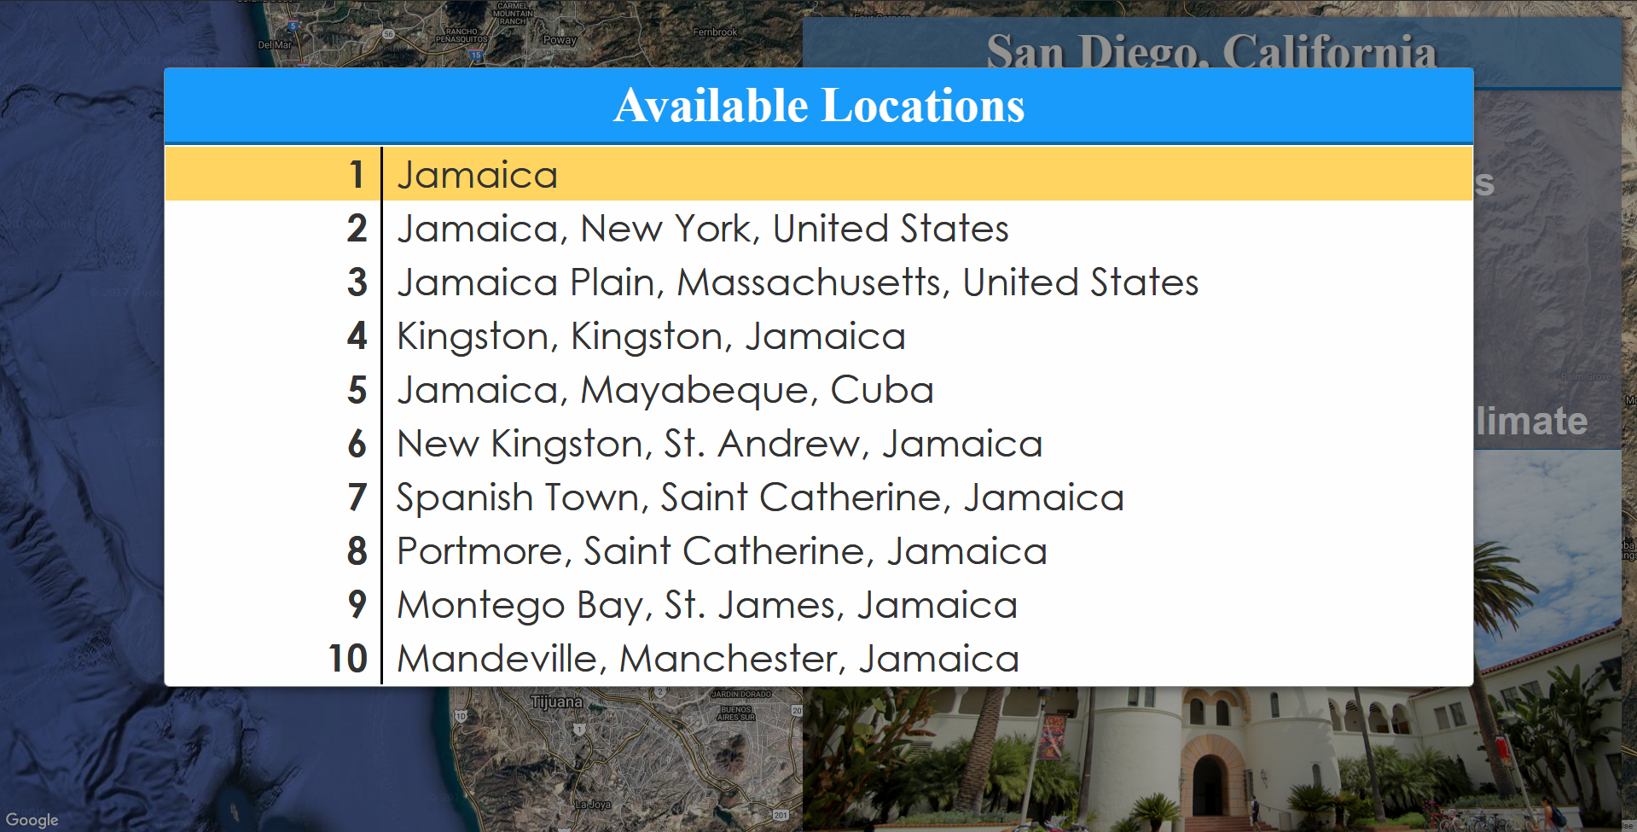
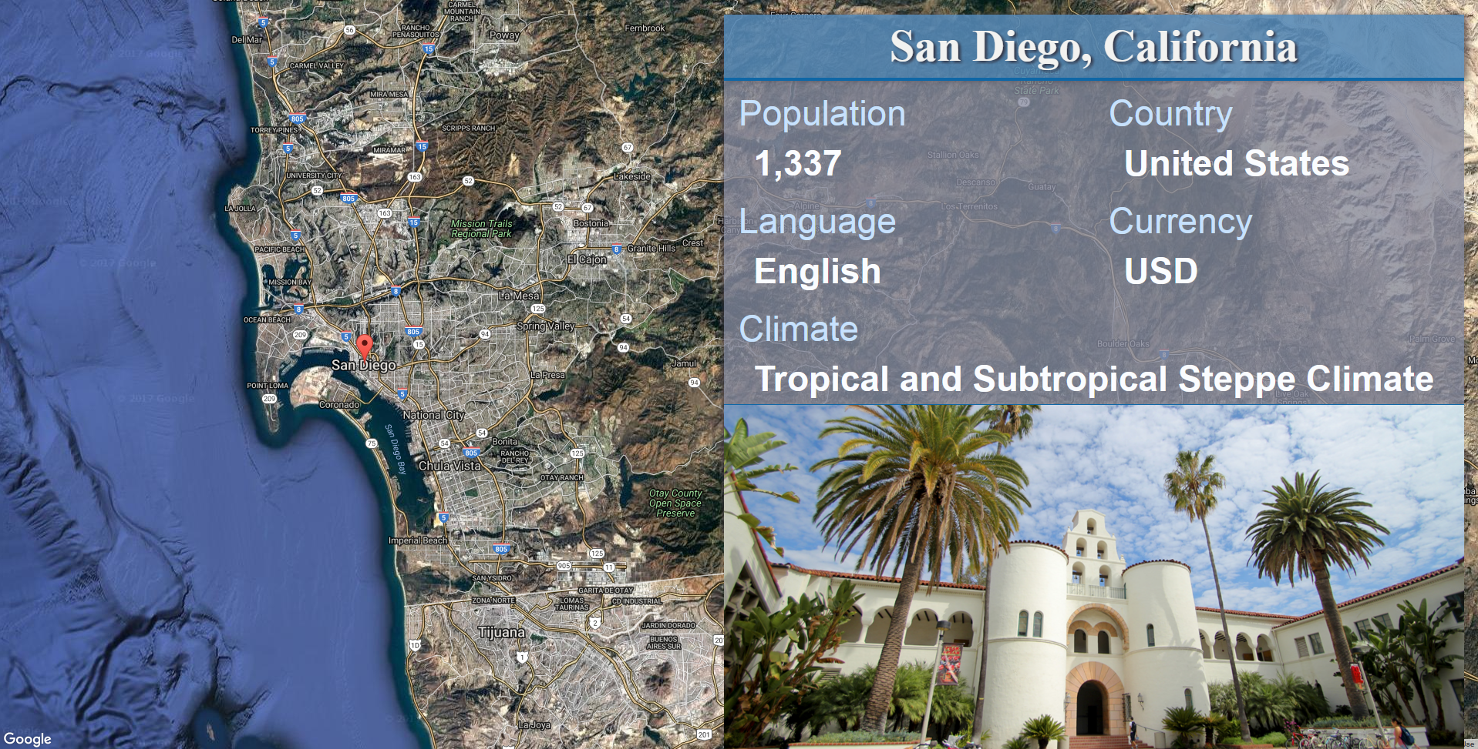
GUI

Slide 18

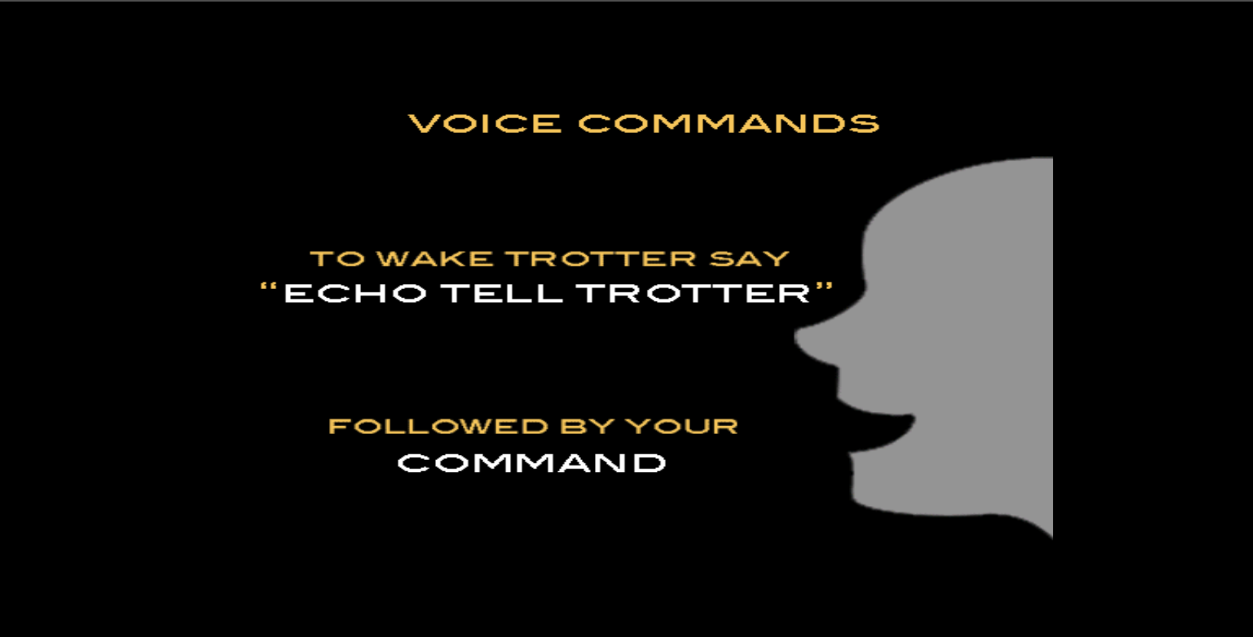
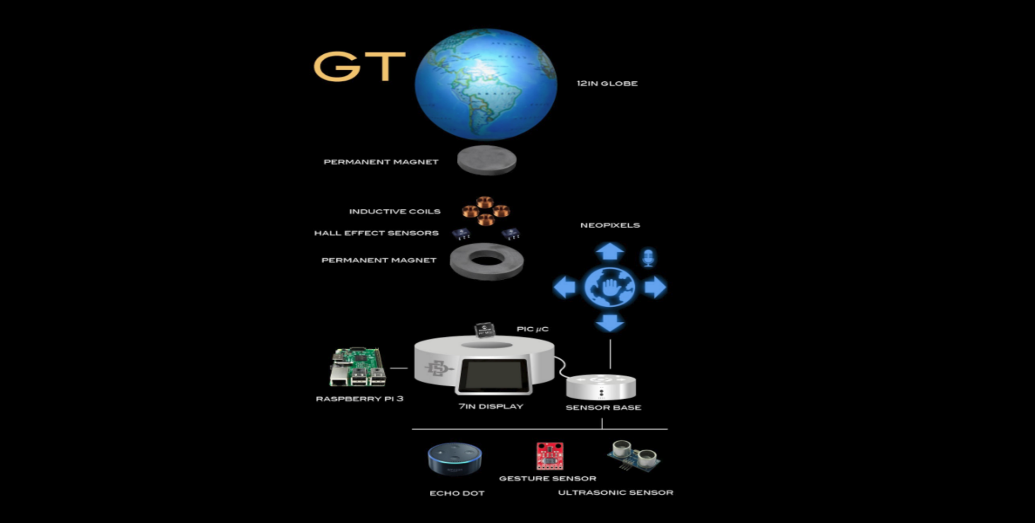
GUI - Additional Displays
Help
About

Slide 19
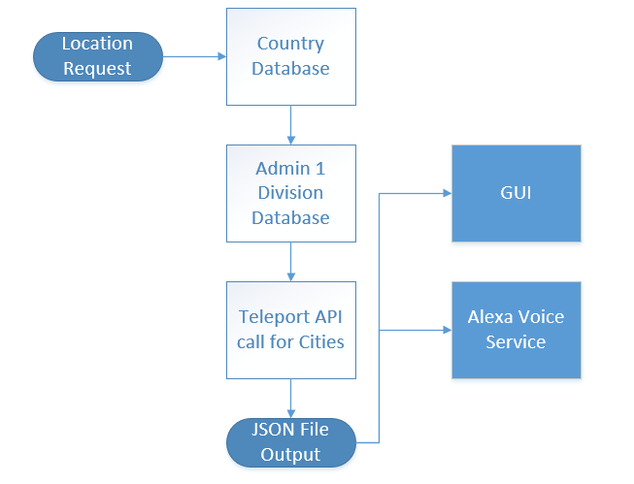
Handling Requests and Location Information
Simplified JSON File Output
[
{
Country1
},
{
Country 2
},
{
State1
},
{
City1
},
{
City2
}
]
Notes:
This is a flowchart for how user requests are being handled.
A user requests a location and we pass the location string into a set of python functions.
The python functions will query our database and make API calls in the order shown in the diagram. So it will query our countries table first, then admin 1 divisions table, and then make API calls to find cities.
The functions will gather any search results they find and append them to a list
This will help refine our searches to include different types of areas with the same name and gives priority to locations with a higher degree of administrative authority.
On the right side you can see that the simplified JSON generated is a list of dictionaries. As you can see, countries will be at the lowest index, then states, then cities.
Gives user the option to select different locations with the same name.

Slide 20


Voice & Gesture Interfaces

Slide 21
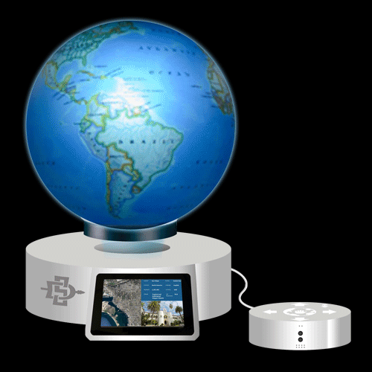
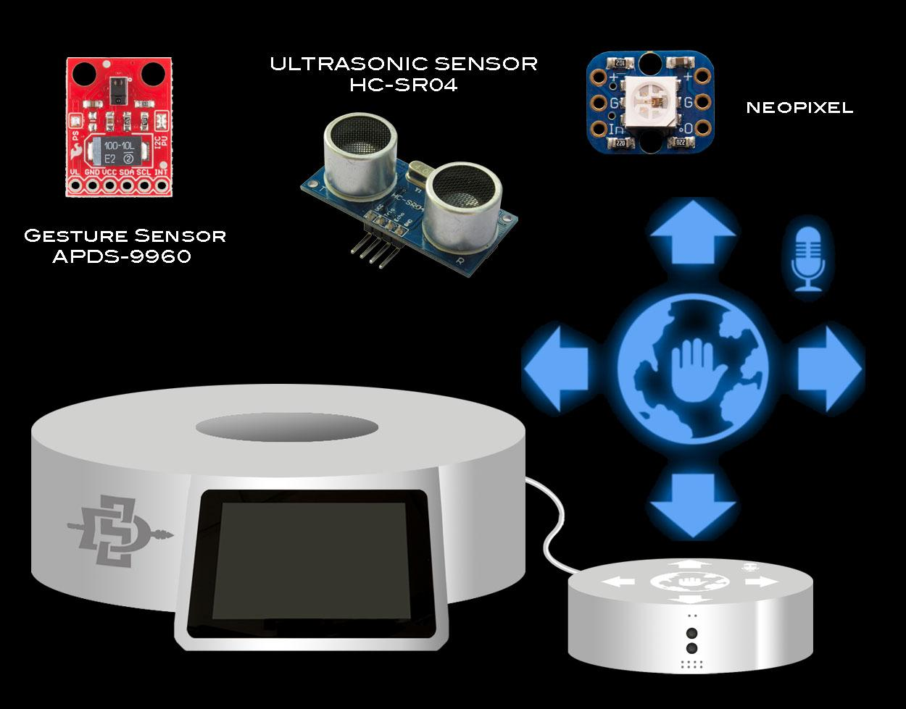
Gesture Recognition
Notes:
- We use the Ultrasonic sensor to detect users within 157 inches
- And with the gesture sensor we detect swipes in 4 directions and proximity with 4 - 8 inches

Slide 22
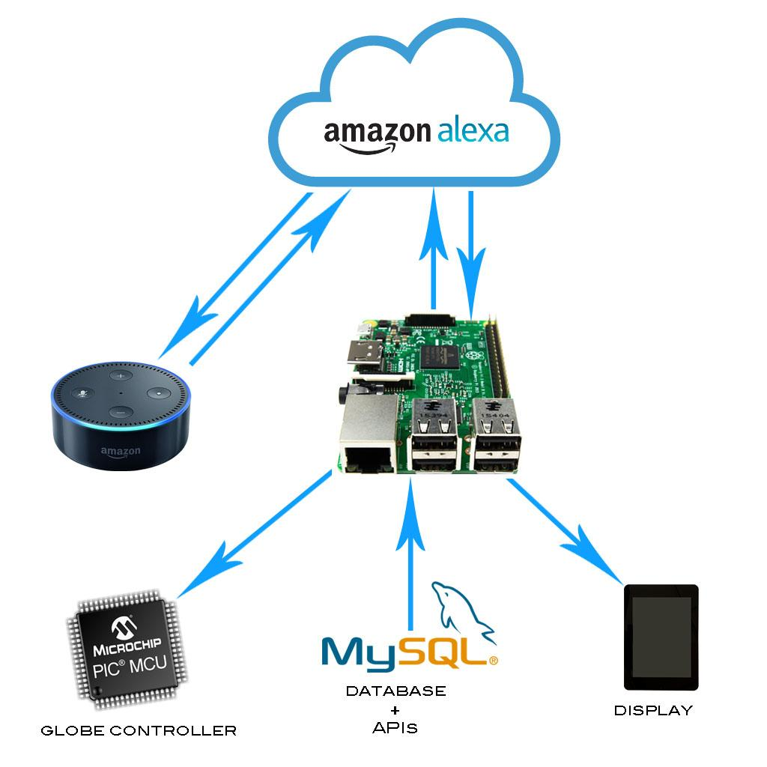
Voice Recognition
Notes:
- The Echo Dot transmits user requests to the Alexa Voice Service in the cloud for Natural Language Processing.
- The Raspberry Pi uses our local database and APIs to generate verbal responses to the user, and also to control the globe and GUI.
- With the voice interface you can say things like
go to San Diego
tell me more details
rotate the globe west
Zoom in on the map
Where have I visited
- You can also ask for help with voice commands or gesture controls.
- Both the voice and gesture interfaces are functional.

Slide 23
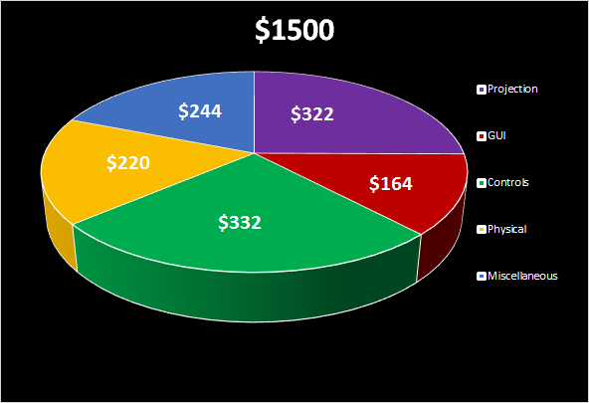
Budget -
Cost Analysis

Slide 24
Milestones
Voice Recognition Controls 4/3/17
Gesture Recognition Controls 4/6/17
Fully Functional Display Software System 4/13/17
Magnet Stabilization System Designed 4/20/17
Base Model Constructed 4/24/17
Levitate the Globe 4/28/17

Slide 25

Conclusions
Notes:
Trotter: Thanks again for coming today. You have been an awesome audience, I mean that from the bottom of my microchip! . I would like to extend a special thank you to our sponsor, Morris Cerullo World Evangelism. Now that you have heard all about me, I would really appreciate your feedback. Does anyone not named Andy have any questions?

